Slide 1

CSC 533: Privacy in the Digital Age (Fall 2020) Lecture 16: Fairness and Transparency in ML
Anupam Das
Oct. 13, 2020

Slide 2
Goals
Fairness
What it means to be fair.
Transparency
How we can achieve better transparency
Some slide contents taken from Solon Barocas, Moritz Hardt, Anupam Datta

Slide 3

AI effects our lives
Widespread algorithms with many small interactions
e.g., search, recommendations, social media
Specialized algorithms with fewer but higher-stakes interactions
e.g., medicine, criminal justice, finance
At this level of impact, algorithms can have unintended consequences
Low classification error is not enough, need fairness
http://www.cs.toronto.edu/~madras/presentations/fairness-ml-uaig.pdf

Slide 4

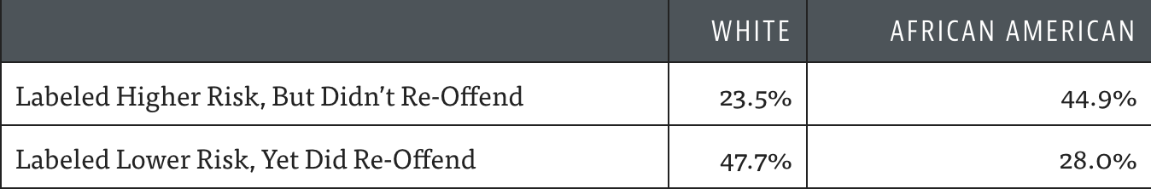
Should a defendant receive bail?
Get
Bail
Yes
No
Pulp Fiction
The model got the decision largely wrong! Adversely, Biased to African American
http://www.cs.toronto.edu/~madras/presentations/fairness-ml-uaig.pdf

Slide 5
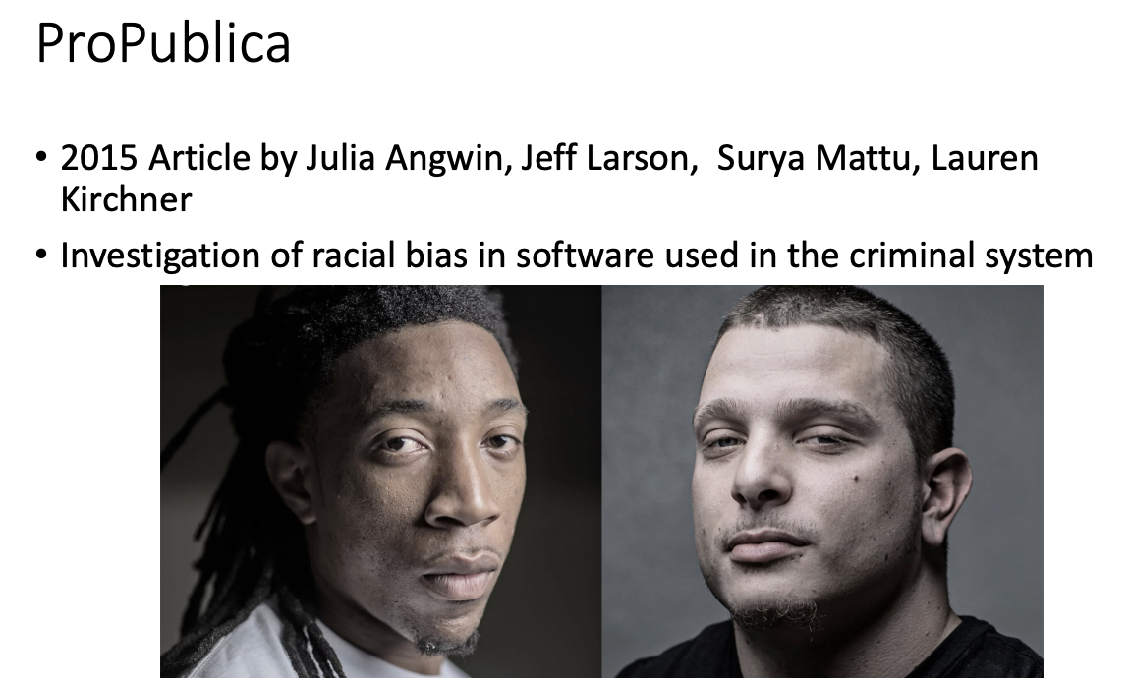
ProPublica
Notes:
ProPublica is an American nonprofit organization based in New York City. It is a nonprofit newsroom that aims to produce investigative journalism in the public interest.

Slide 6
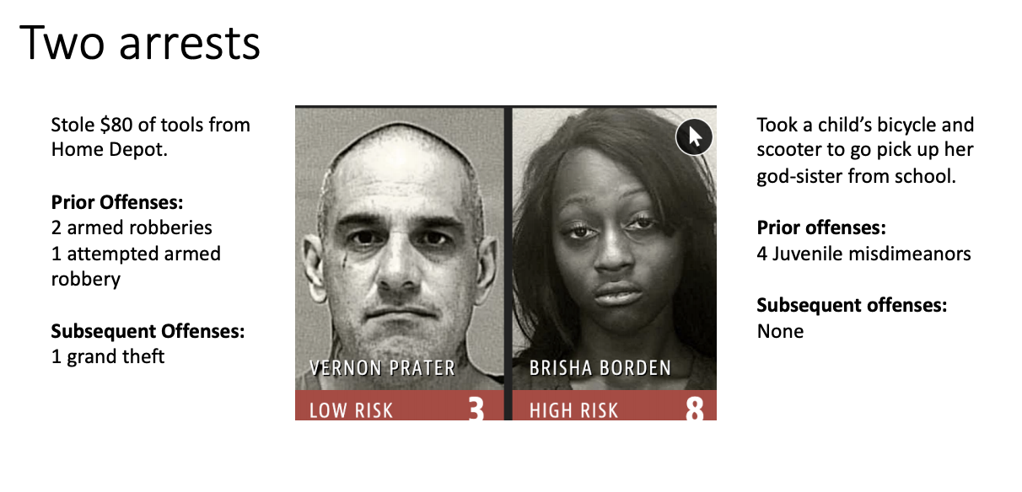
Example

Slide 7
Risk score system
• Increasingly common in courtrooms
• E.g., Northpointe software
• Used to inform who can be set free
• Results are sometimes given to judges during sentencing
• Sentencing Reform and Corrections Act (2015)
• Enables the use of these tools in federal prisons
• Eric Holder (US Attorney General, 2014) warned about bias in these tools
• No formal action was taken

Slide 8
In language modeling
phrases referring to women often become ‘he said’ or ‘he wrote’ during translation
word embedding algorithm characterizes European American names as pleasant and African American ones as unpleasant
https://www.nature.com/articles/d41586-018-05707-8

Slide 9
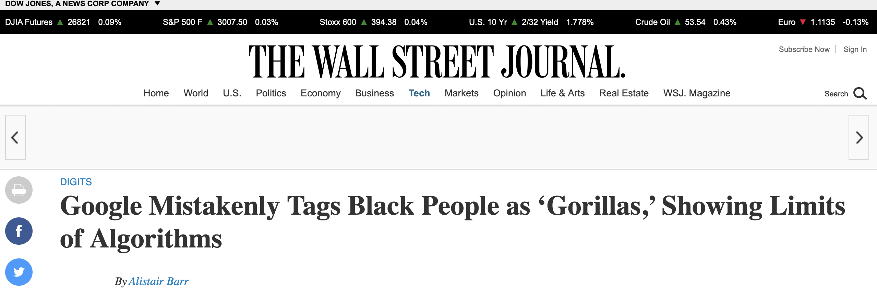
In computer vision
camera interpret Asians as always blinking
misclassify people with darker skin color
https://www.nature.com/articles/d41586-018-05707-8

Slide 10
Fairness in ML

Slide 11
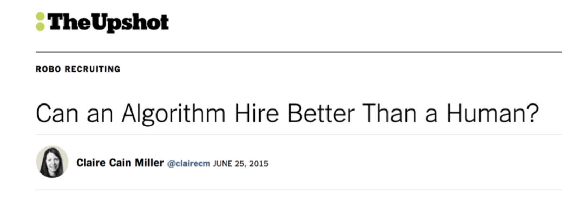
ML can be great!
"[H]iring could become faster and less expensive, and […] lead recruiters to more highly skilled people who are better matches for their companies. Another potential result: a more diverse workplace. The software relies on data to surface candidates from a wide variety of places and match their skills to the job requirements, free of human biases."
https://mrtz.org/nips17/#/

Slide 12
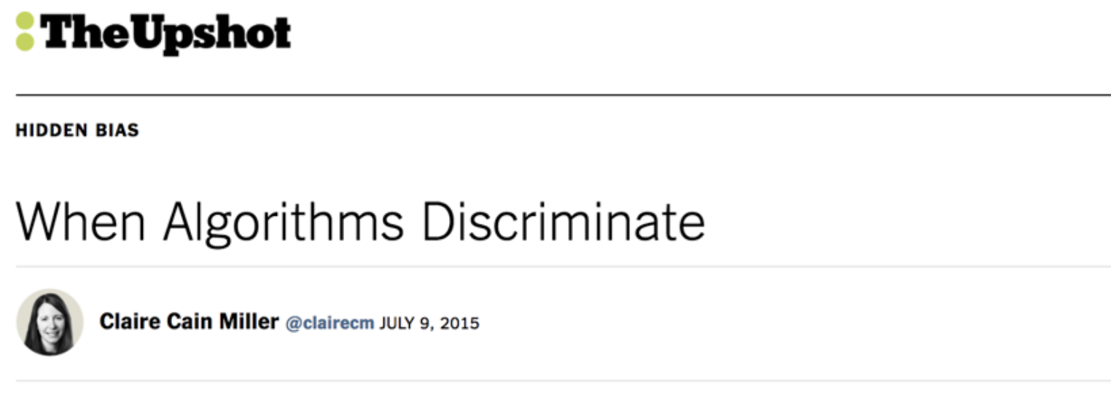
But wait … what about discriminations?
"But software is not free of human influence. Algorithms are written and maintained by people, and machine learning algorithms adjust what they do based on people’s behavior. As a result […] algorithms can reinforce human prejudices."

Slide 13
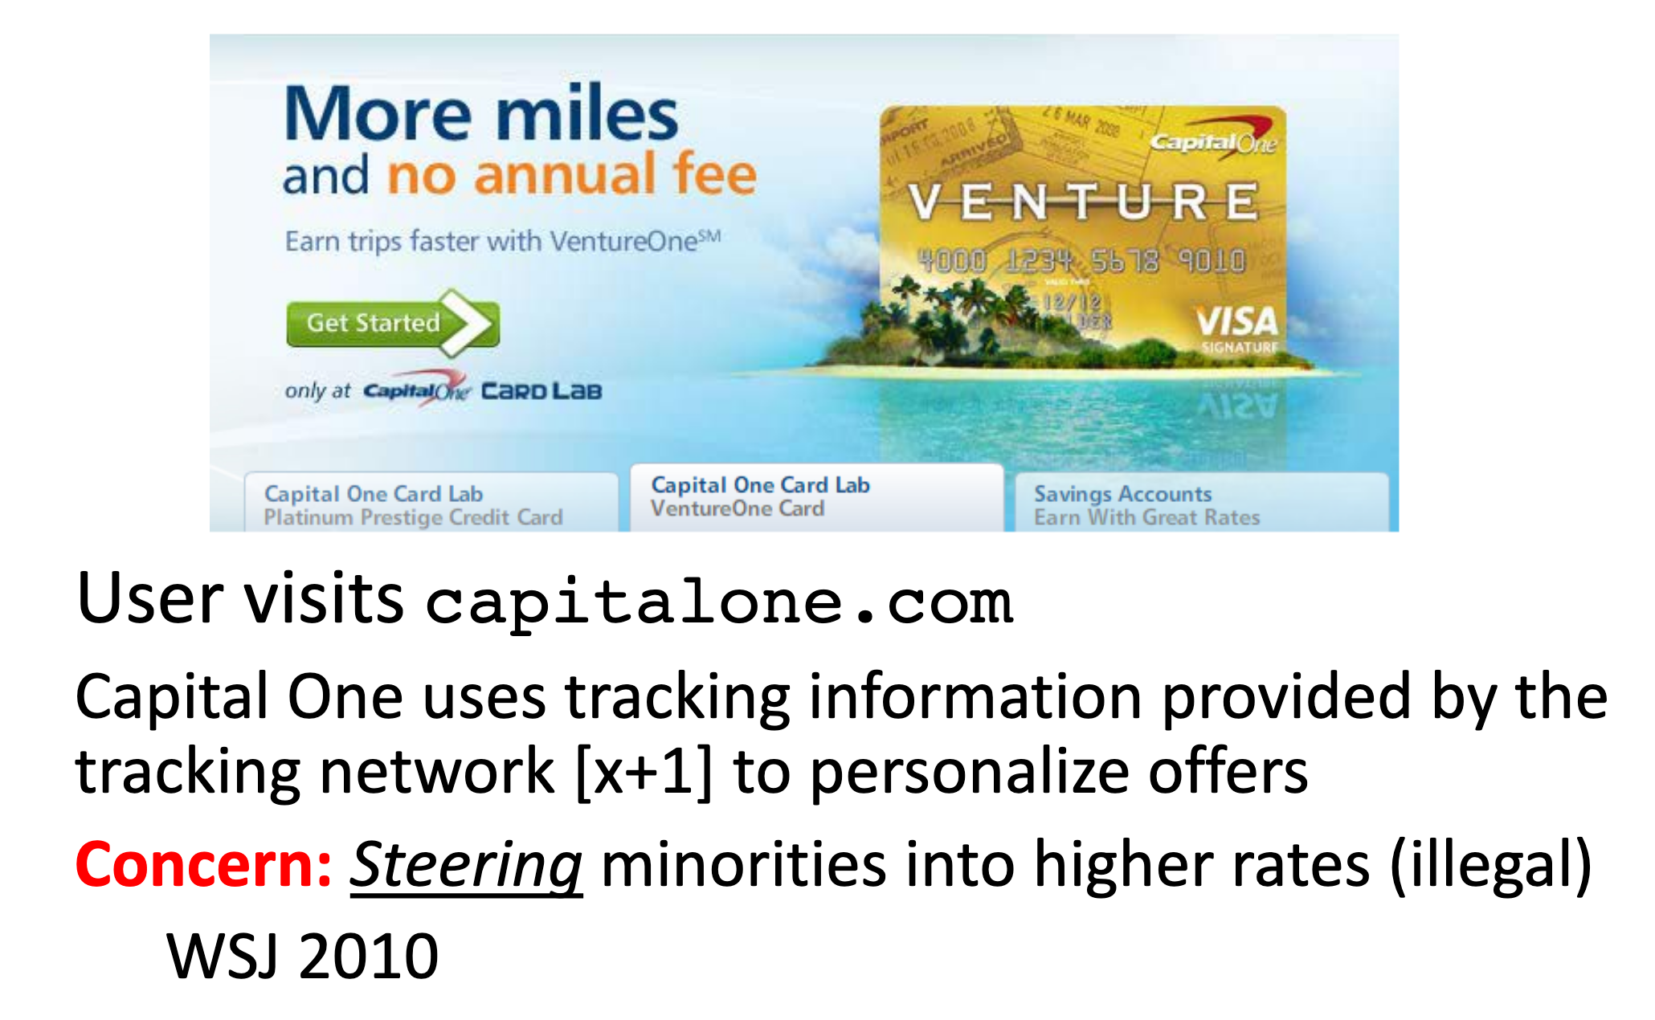
Another example: Credit card application (infer race from ZIP code)

Slide 14
Isn’t discrimination the very point of machine learning?
Yes, but we don’t want -
Unjustified basis for differentiation (the basis of the discrimination should be justifiable in some way)
Practical irrelevance (e.g., African American or Latinos are less likely to repay loan)
Moral irrelevance (e.g., someone with disability is not considered for employment)

Slide 15
Discrimination is not a general concept
It is domain specific
Concerned with important opportunities that affect people’s life chances
It is feature specific
Concerned with socially salient qualities that have served as the basis for unjustified and systematically adverse treatment in the past (e.g., undesirable social norms)

Slide 16
Regulated domains
Regulations can provide us some ideas about what makes a decision unfair or even unethical
Credit (Equal Credit Opportunity Act)
Education (Civil Rights Act of 1964; Education Amendments of 1972)
Employment (Civil Rights Act of 1964)
Housing (Fair Housing Act)
‘Public Accommodation’ (Civil Rights Act of 1964)
Extends to marketing and advertising; not limited to final decision
This list sets aside complex web of laws that regulates the government itself.

Slide 17
Legally defined as ‘protected class’ (growing list)
Race (Civil Rights Act of 1964); Color (Civil Rights Act of 1964); Sex (Equal Pay Act of 1963; Civil Rights Act of 1964); Religion (Civil Rights Act of 1964); National origin (Civil Rights Act of 1964); Citizenship (Immigration Reform and Control Act); Age (Age Discrimination in Employment Act of 1967); Pregnancy (Pregnancy Discrimination Act); Familial status (Civil Rights Act of 1968); Disability status (Rehabilitation Act of 1973; Americans with Disabilities Act of 1990); Veteran status (Vietnam Era Veterans' Readjustment Assistance Act of 1974; Uniformed Services Employment and Reemployment Rights Act); Genetic information (Genetic Information Nondiscrimination Act)

Slide 18
What could lead to unfairness?
Neither data in itself nor algorithms explicitly know of social inequities
Data collection, labeling etc. can have unintentional biases
We learn from past data, historic biases
At times biases go unnoticed as we view them or accept them as acceptable social norms
Other times the context under which data was collected gets lost in the pipeline or context doesn’t even gets considered

Slide 19
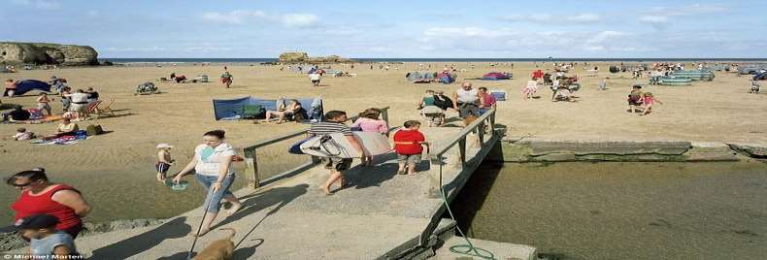

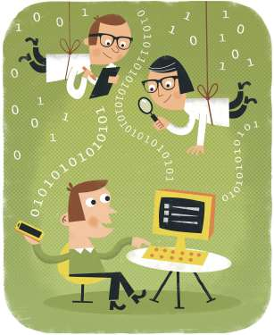
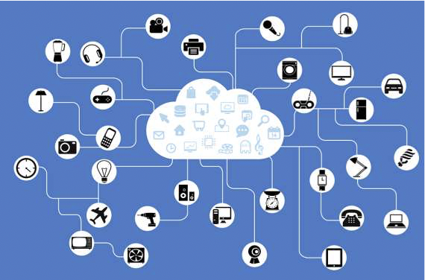



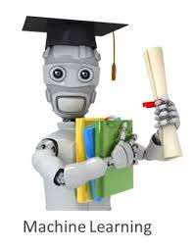


Dramatic Changes in Machine Learning
Rise of fast/cheap data collection, processing
Rise of popular, easy-to-use tools
Rise of Data Scientist Factories

Slide 20
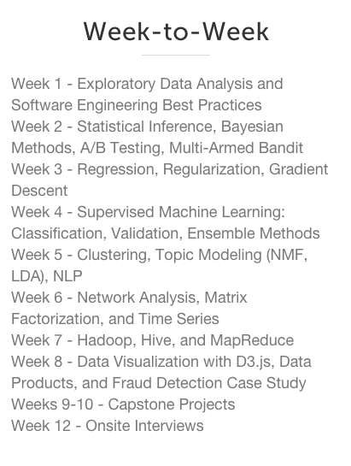
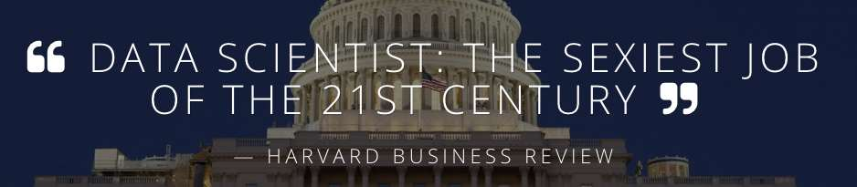
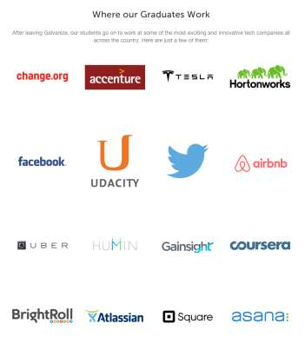
Quick way to become a data scientist
Should everything that can be predicted, be predicted?
If you really have to predict, what should you be aware of?

Slide 21
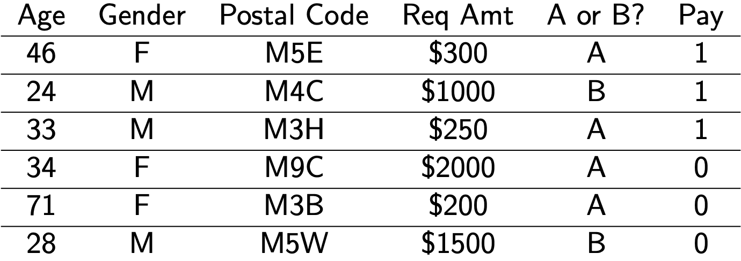
Why fairness is hard?
Suppose we are a bank trying to fairly decide who should get a loan i.e. Who is most likely to pay us back?
Suppose we have two groups, A and B (the sensitive attribute)
This is where discrimination could occur
What would you do?

Slide 22
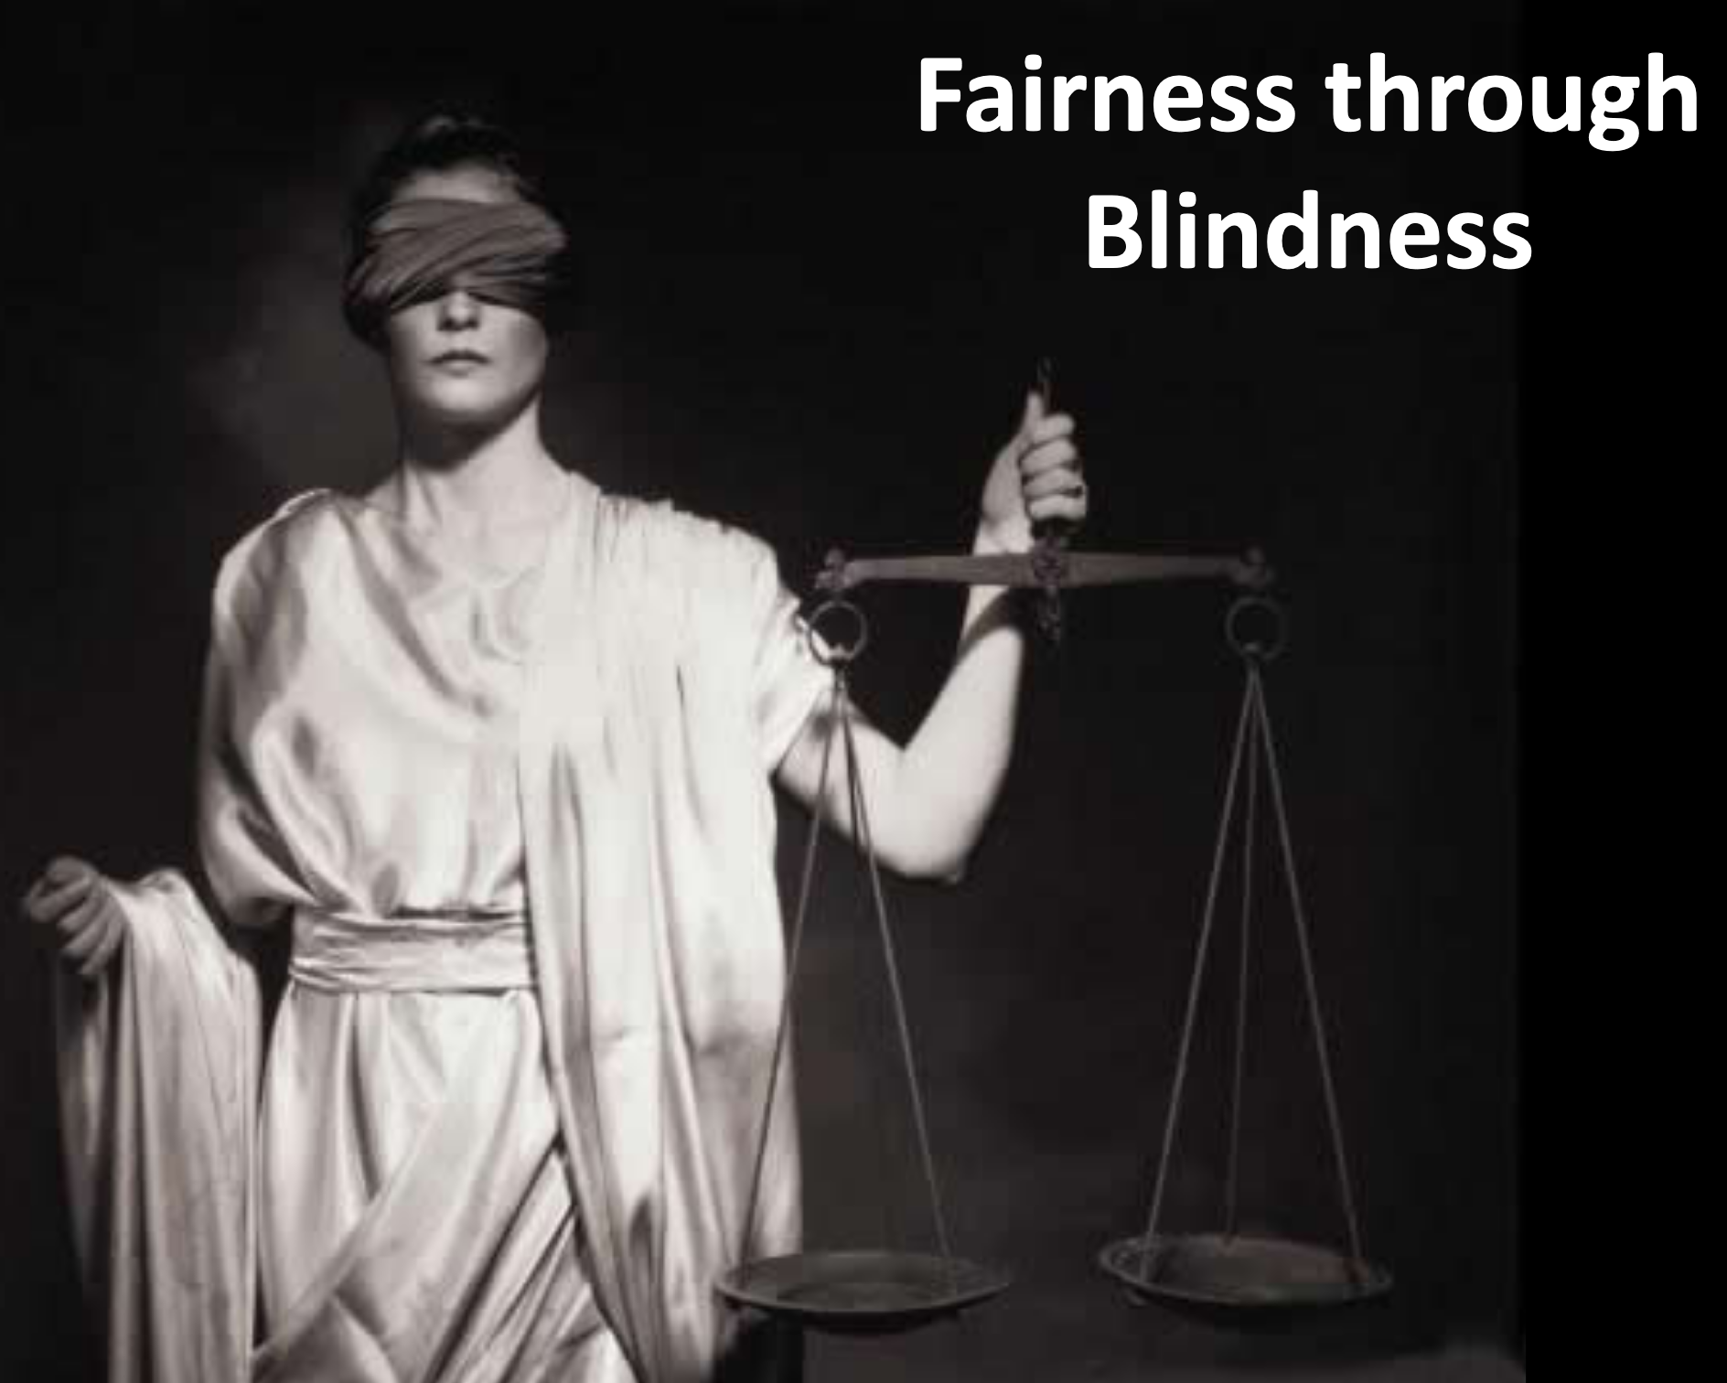
1st Attempt: Fairness through blindness
Ignore all irrelevant/protected attributes
“We don’t even look at ‘race’!”
You don’t need to see an attribute to be able to predict it with high accuracy
E.g.: User visits artofmanliness.com ... 90% chance of being male

Slide 23
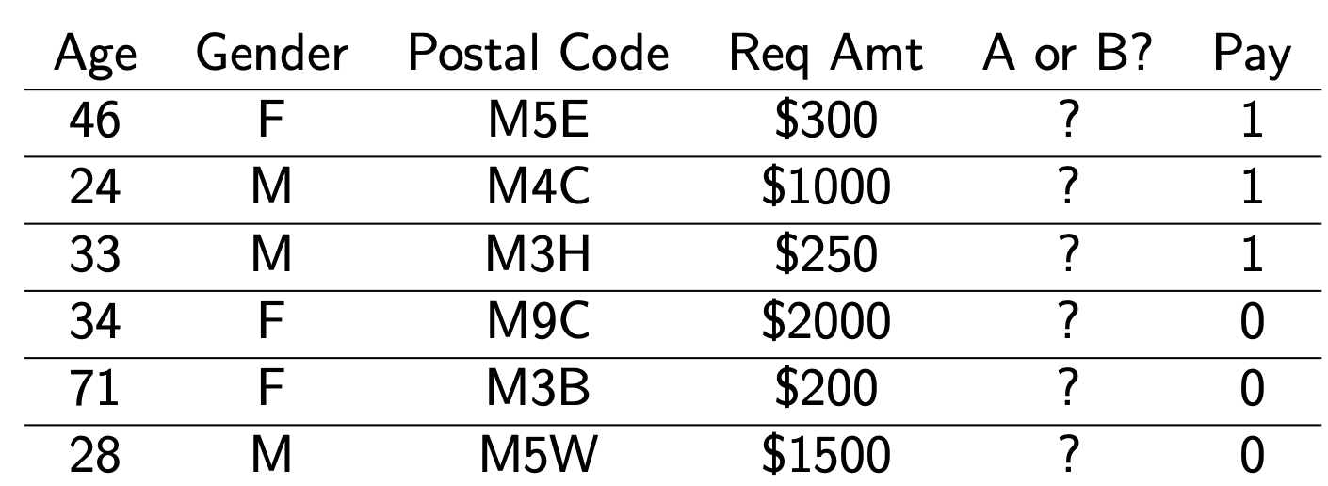
Mask sensitive attributes?
However, if the sensitive attribute is correlated with the other attributes, this isn’t good enough
It is easy to predict race if you have lots of other information (e.g., zip code, spending patterns)

Slide 24
2nd attempt: Statistical Parity
S : Protected subset
S^{c} : Rest of the population
S
Check if the probability of the outcome is similar across groups
Pr(Outcome|S) ≅ Pr(Outcome|S^{c} )
S^{C}
“Fraction of people in S getting loan same as in S^{c}”.
When we make an error, the direction of that error is equally likely for both groups
P(loan|no repay, S) = P(loan|no repay, S^{c})
P(no loan|would repay, S) = P(no loan|would repay, S^{c})
Population

Slide 25
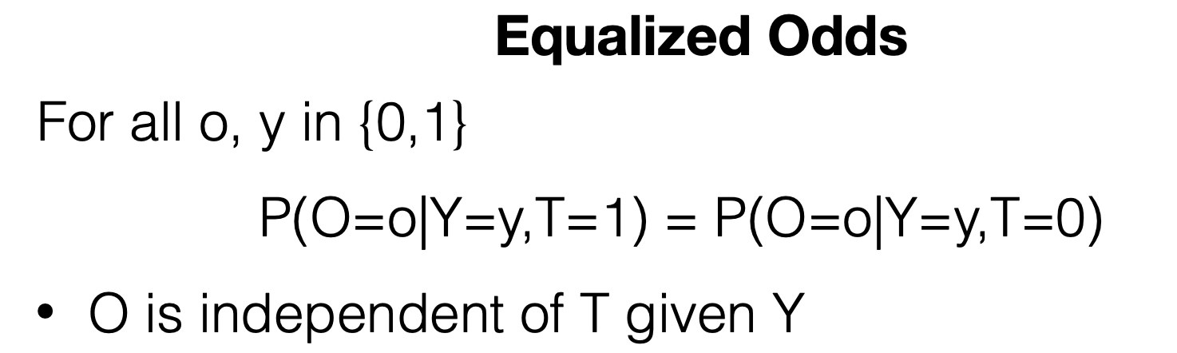
Statistical Parity: Equalized Odds
Variable T: indicated protected class or not
Output variable O: Indicates our prediction or outcome
Variable Y: indicates true/target/desired outcome (e.g., Individual capable/qualified, individual can afford or repay loan etc.)

Slide 26
Statistical parity may not be enough
Not strong enough as a notion of fairness
Sometimes desirable, but can be abused
Self-fulfilling prophecy
Give credit offers to those in S who are not interested in credit.
Offer job to least qualified candidate – will probably not take the job
Group fairness != Individual fairness

Slide 27
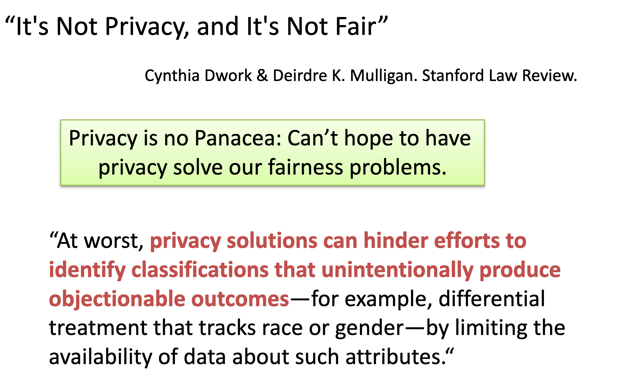
Fairness through Privacy?
Privacy solutions can help hide identities at best, but fairness means to ensure everyone or group is equally treated.
For example, a privacy-preserving mechanism might hide whether a participant is male or female or has disabilities, but it can’t help if the ML is disparate towards gender or disability.

Slide 28
How machines learn to discriminate
Things to keep in mind while building a ML model
Skewed sample: heavy towards one group
Tainted examples: wrongly labeled or categorized samples
Limited features: less informative (has only partial view)
Proxies: correlated data can reveal information B, Selbst (2016)

Slide 29
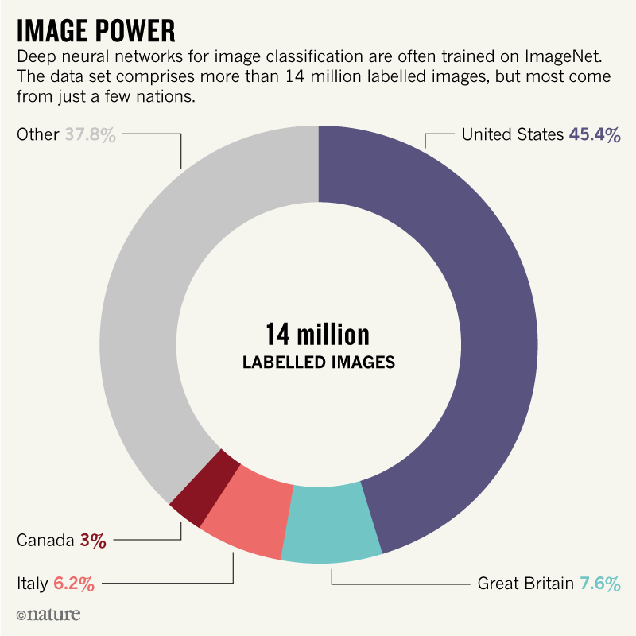
Skewed data
can bias the algorithms if there is no constraint and intervention.
Dark side of “data-driven” magic
Back in 2015, software engineer Jacky Alciné pointed out that the image recognition algorithms in Google Photos were classifying his black friends as “gorillas.”
https://www.nature.com/articles/d41586-018-05707-8

Slide 30
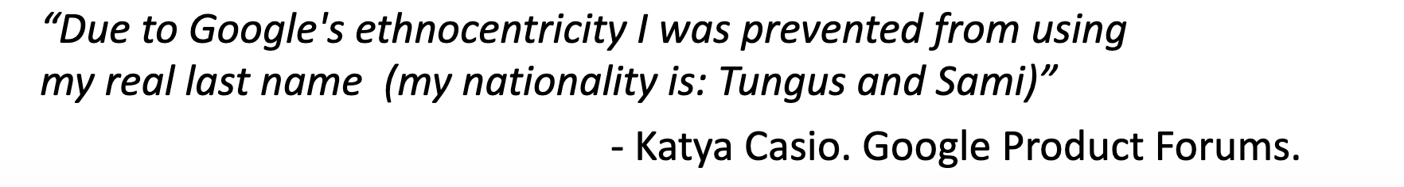
Disparity in samples
Google+ tries to classify real vs. fake names
Fairness problem:
–Most training examples standard white American names: John, Jennifer, Peter, Jacob, ...
–Ethnic names often unique, much fewer training examples
Likely outcome: Prediction accuracy worse on ethnic names

Slide 31
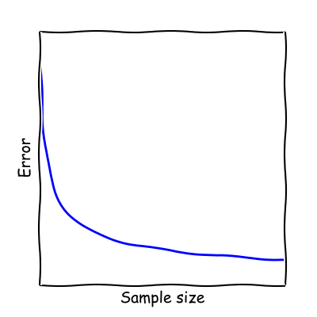
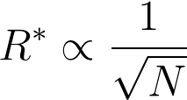
Error vs. sample size
Classifier error rate
N: Number of training examples in your data
Sample Size Disparity:
In a heterogeneous population,
smaller groups face larger error

Slide 32
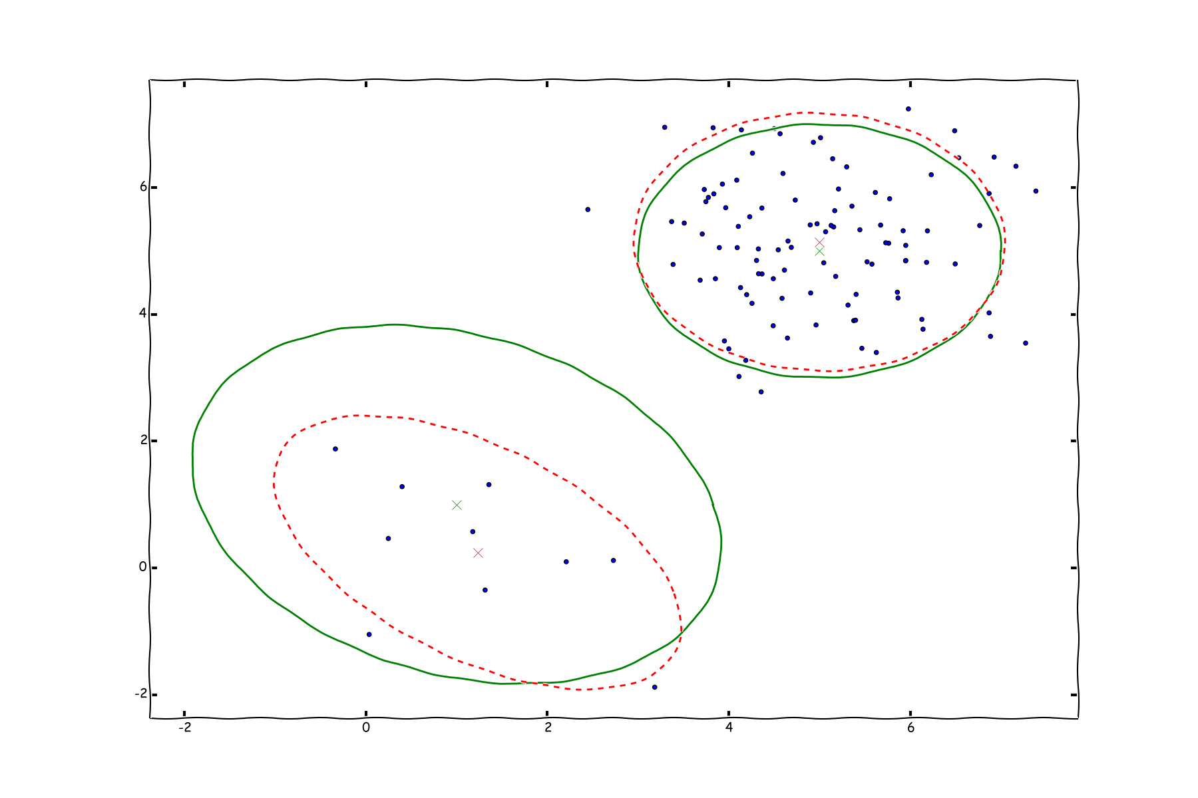
Error vs. sample size
Decision boundary
Desired boundary
More data better decision boundaries

Slide 33
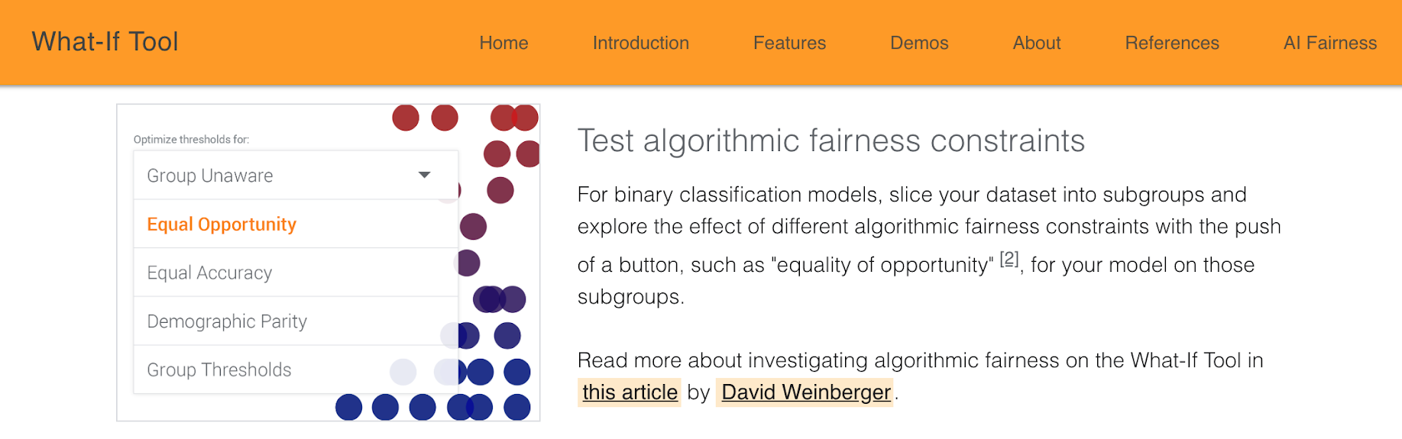
Tools for testing algorithmic fairness
https://pair-code.github.io/what-if-tool/

Slide 34
Algorithmic transparency

Slide 35
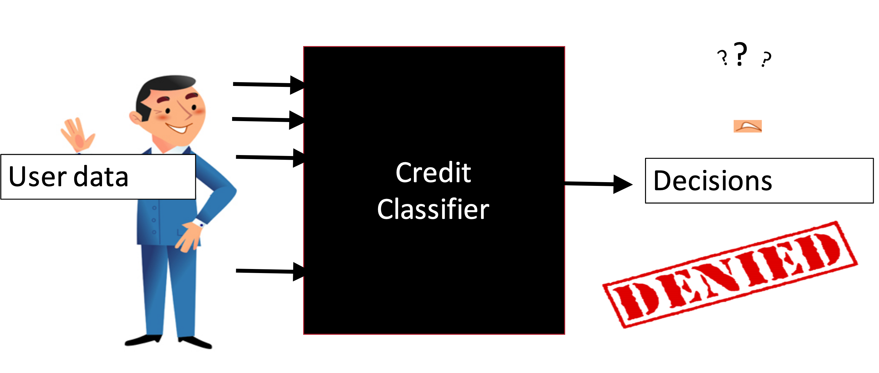
Machine learning systems are opaque

Slide 36
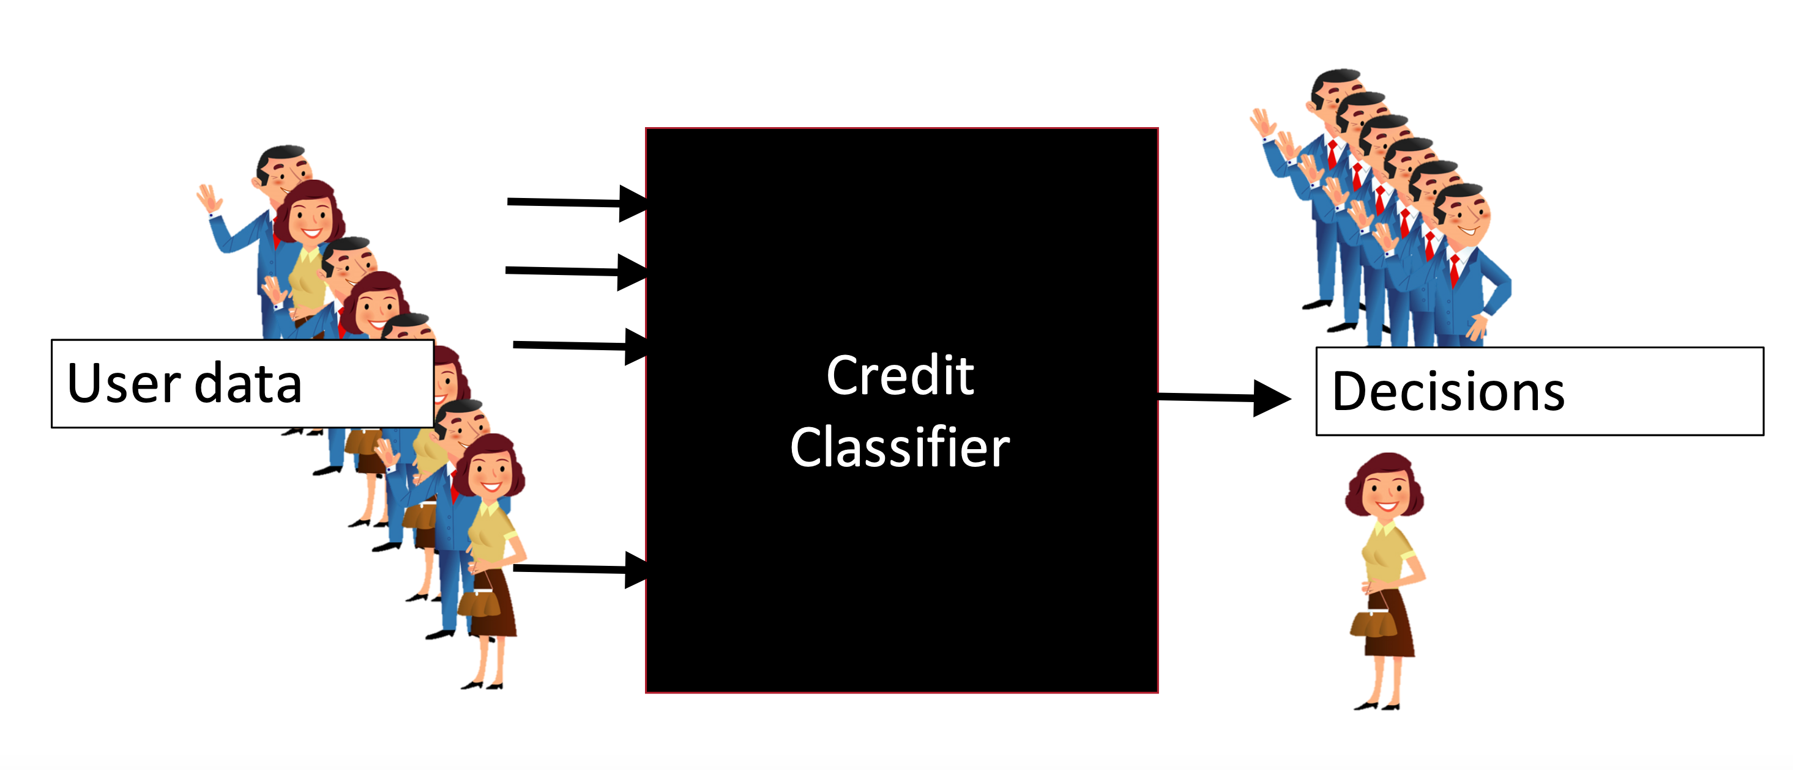
Decisions vary across input

Slide 37
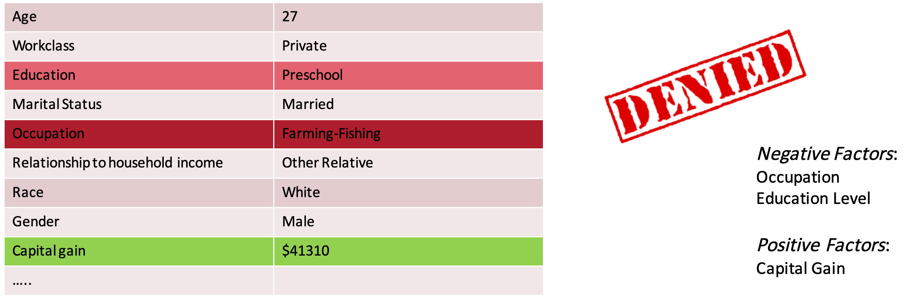
Transparency through explanation
How much influence do various inputs (features) have on a given classifier’s decision about individuals or groups?

Slide 38
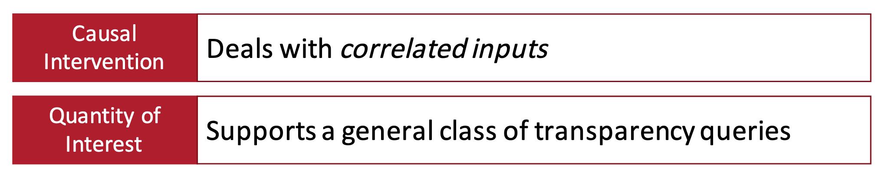
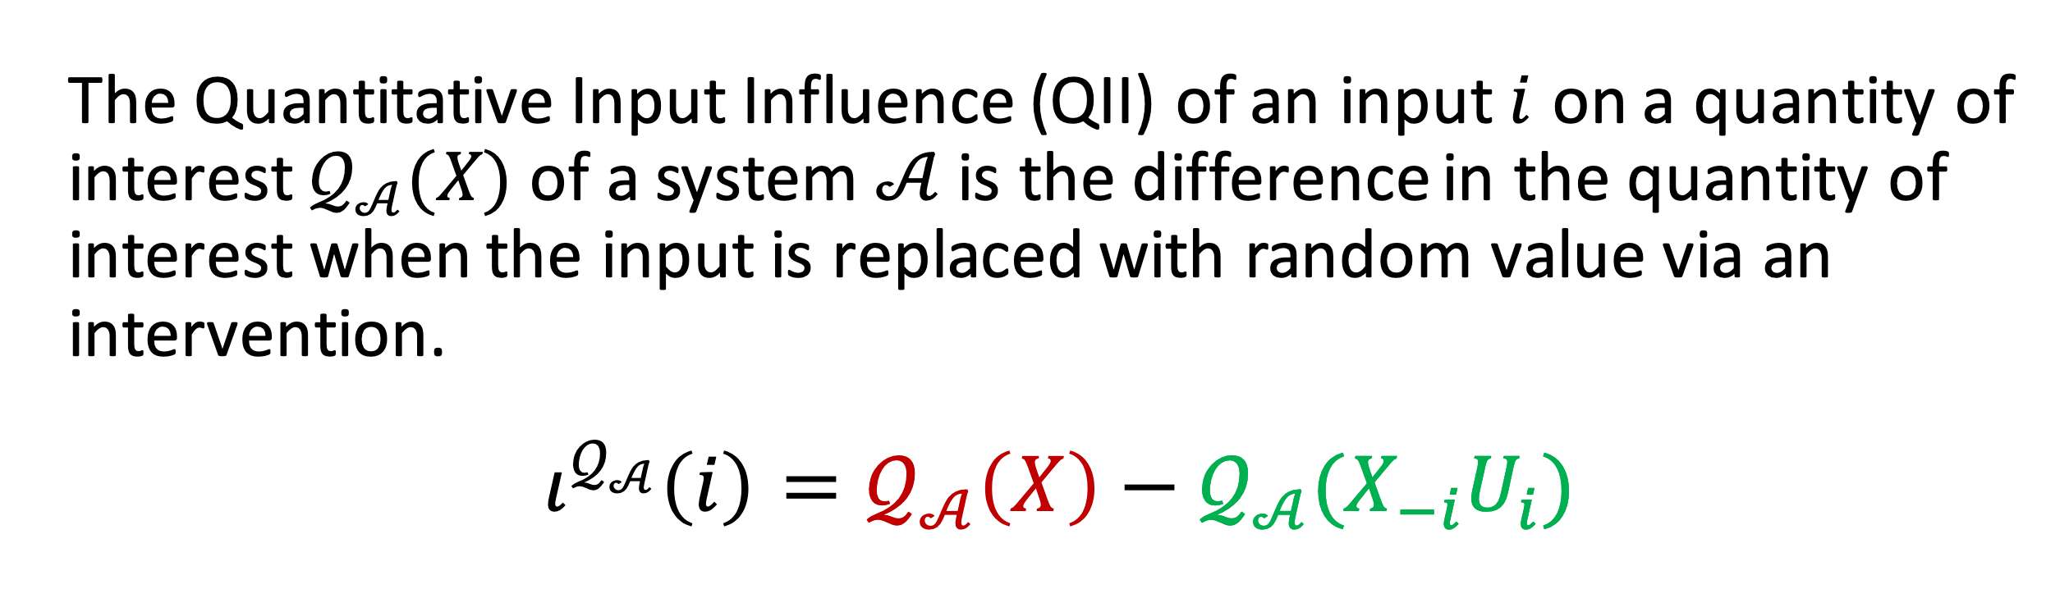
Quantitative Input Influence (QII)
A technique for measuring the influence of an input of a system on its outputs. Can enable -

Slide 39
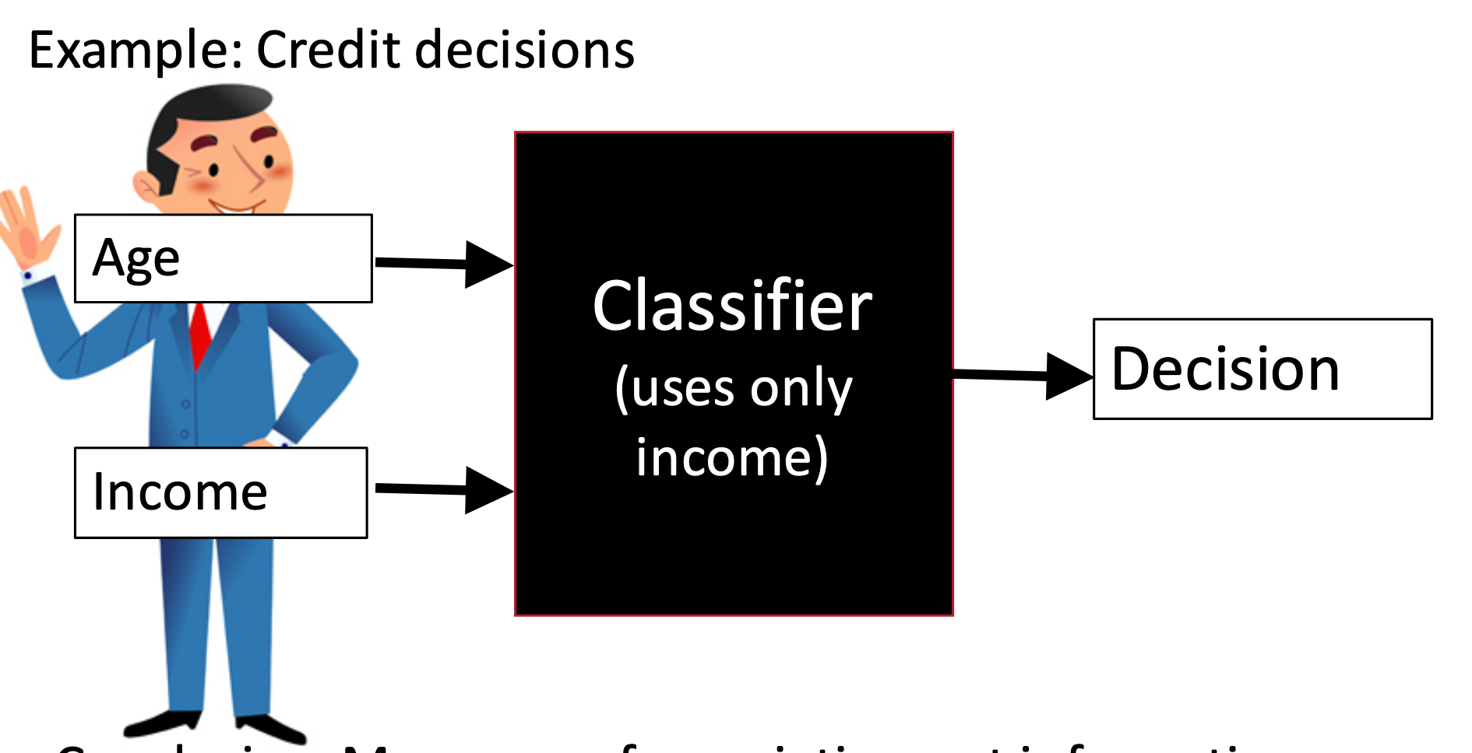
Input correlation
ML is Blackbox: don’t know how inputs impact outcome

Slide 40


Causal intervention
25 Yr
25 Yr
$60K
$120K
Replace feature with random values from the population, and examine distribution over outcomes.

Slide 41
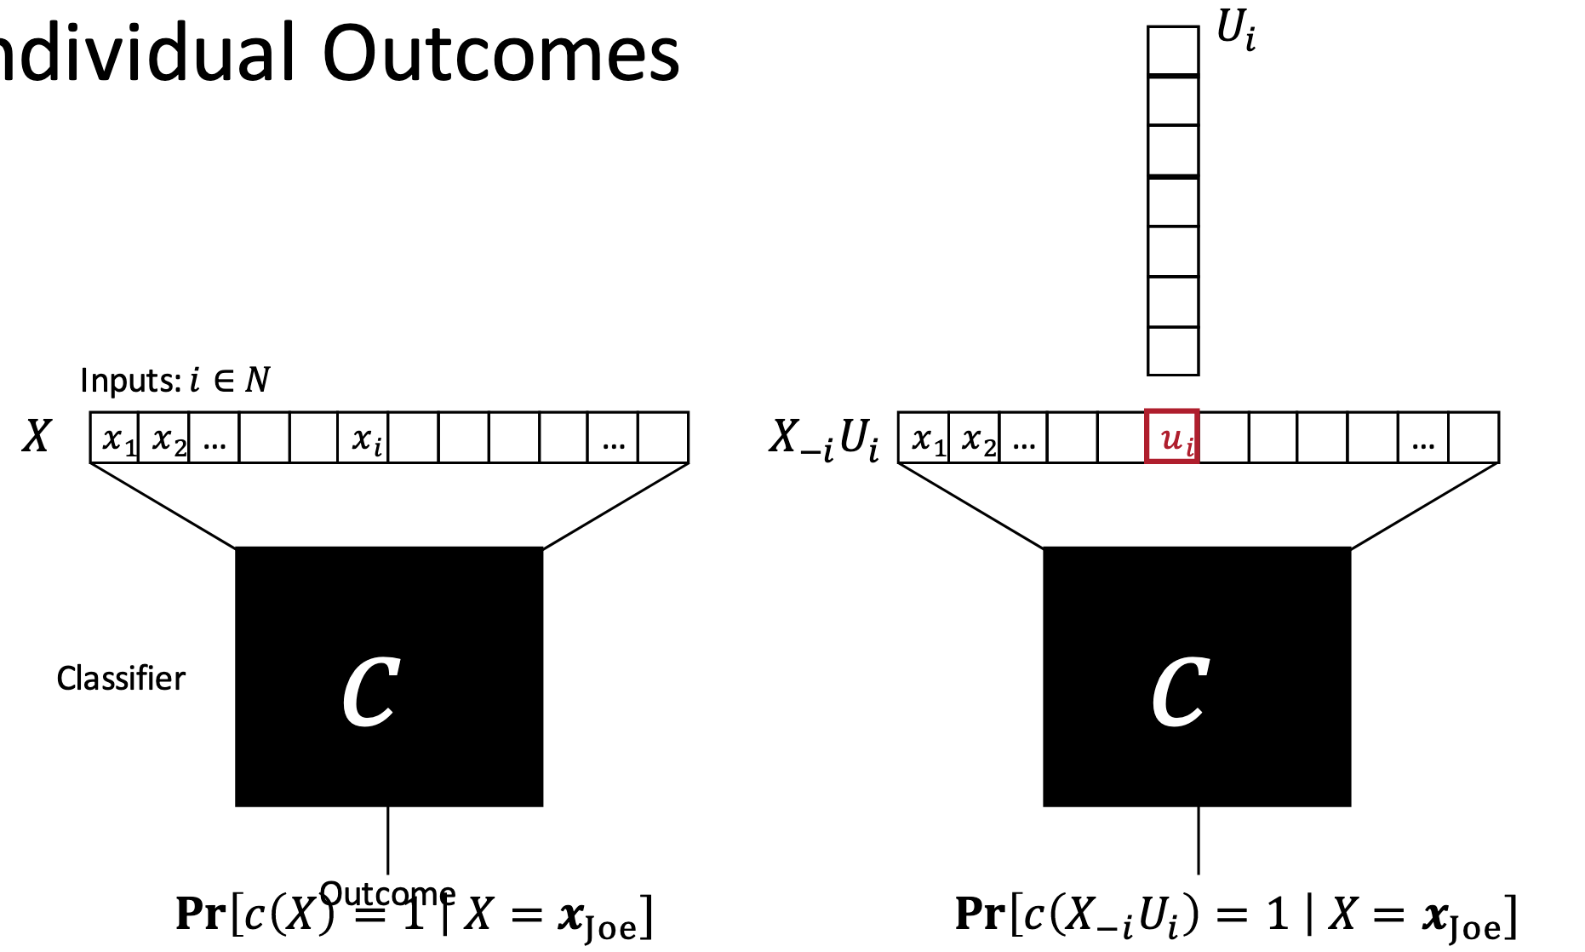
QII for individual feature
Causal Intervention: Replace feature with random values from the population, and examine distribution over outcomes.
Outcome
Input feature values

Slide 42
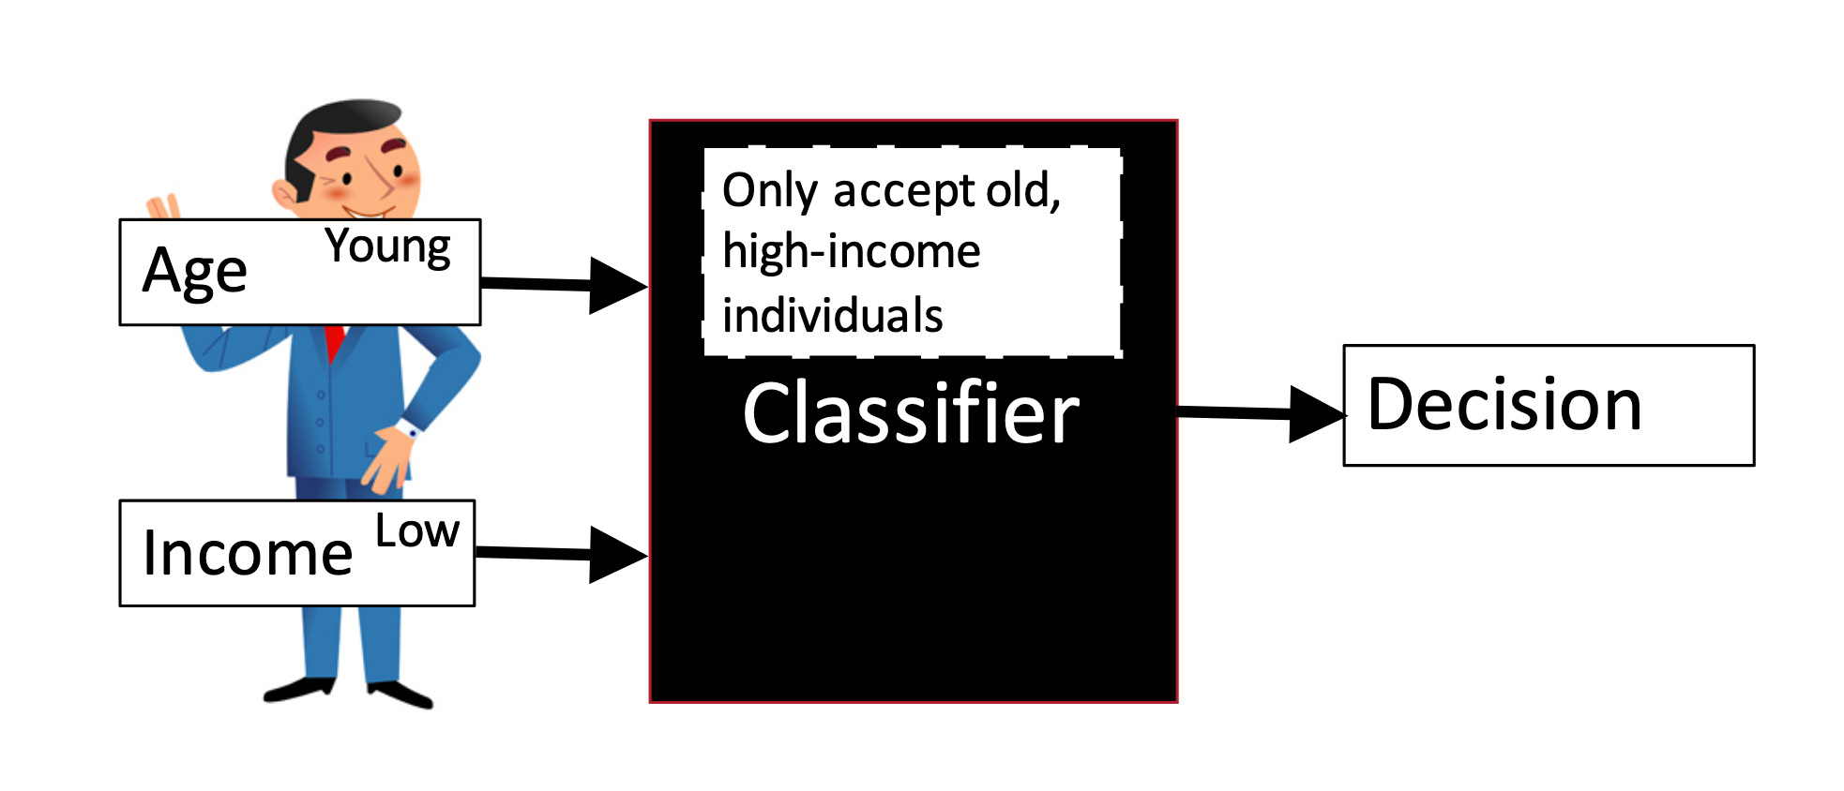
Single inputs may have low influence
May need to test by simultaneously changing multiple inputs

Slide 43
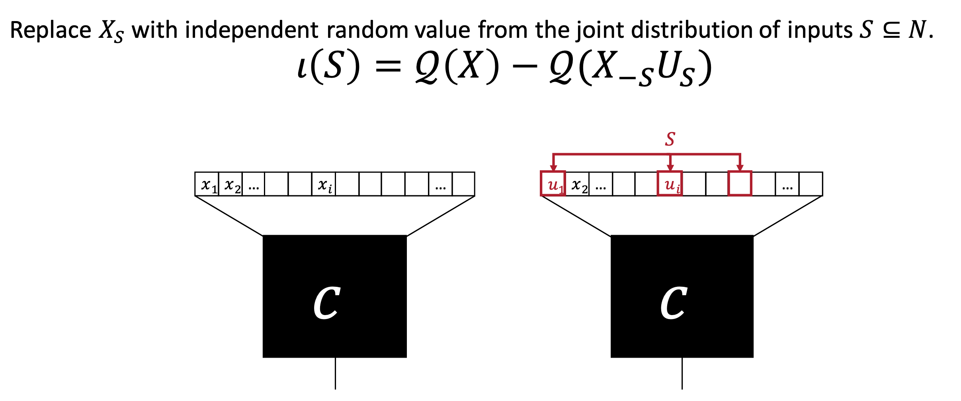
Set QII: change a set of inputs
Tricky can easily explode as feature space increases

Slide 44
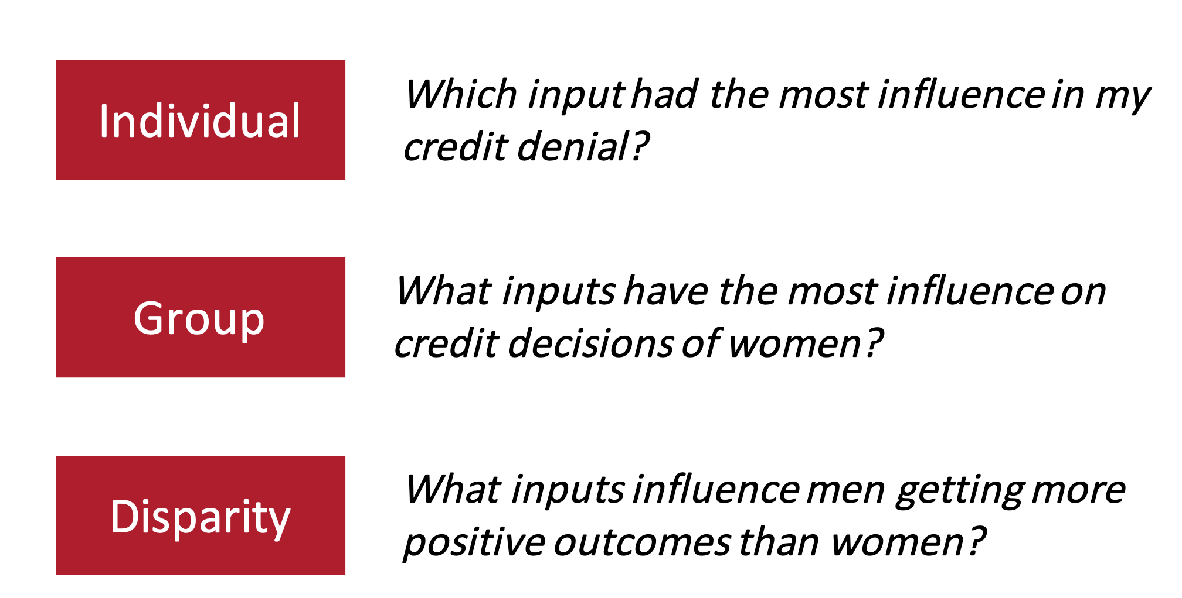
General class of transparency queries

Slide 45
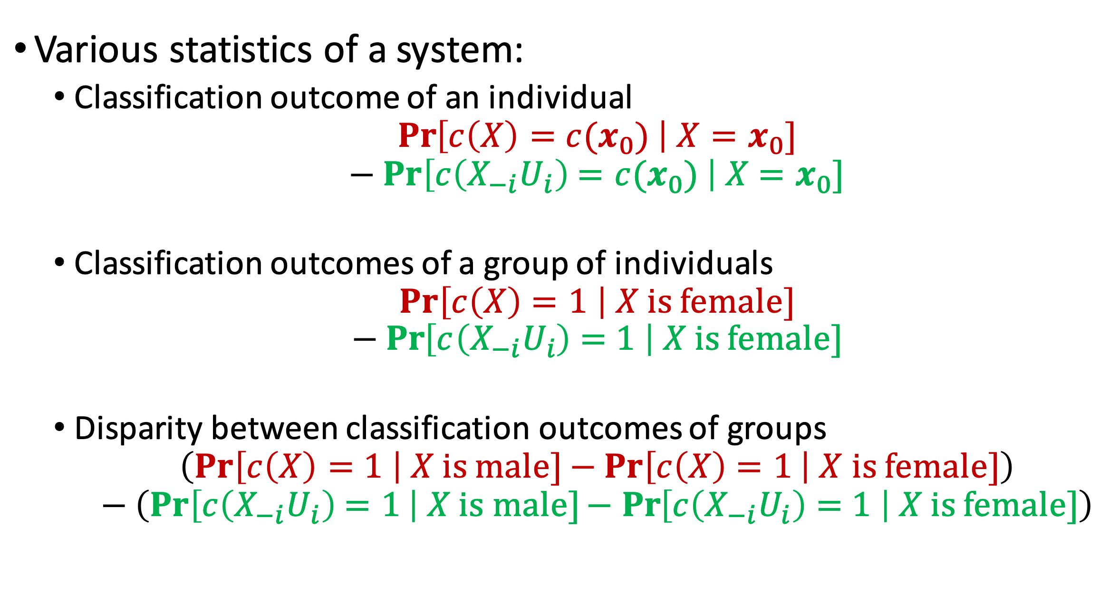
Quantity of interest

Slide 46
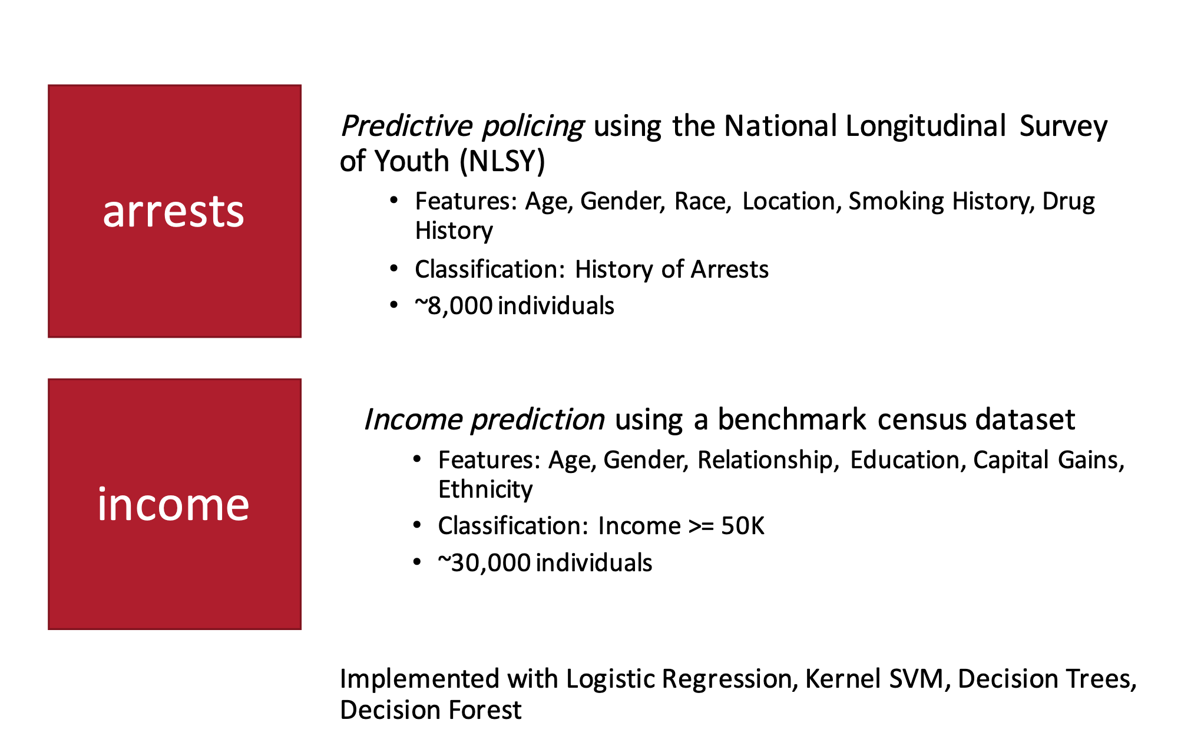
Experiments: Test applications

Slide 47
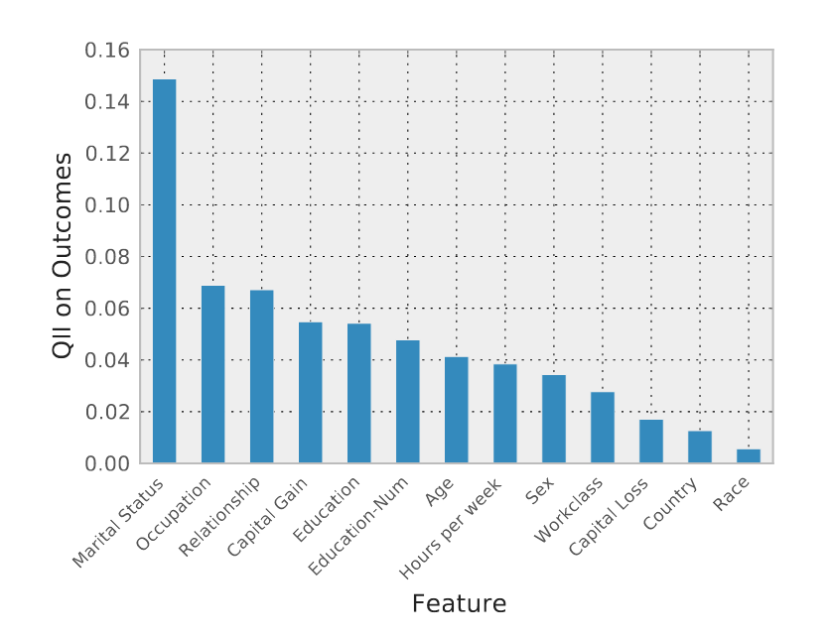
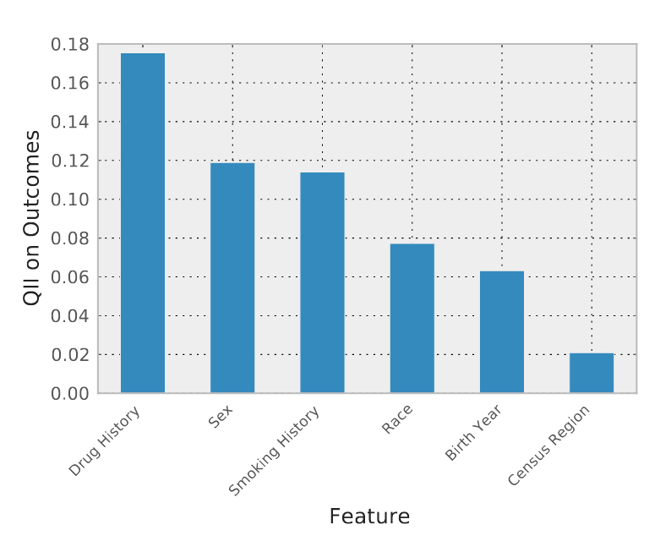
QII of inputs
QII of inputs on Outcomes for the adult (income) dataset
QII of inputs on Outcomes for the arrest datase

Slide 48
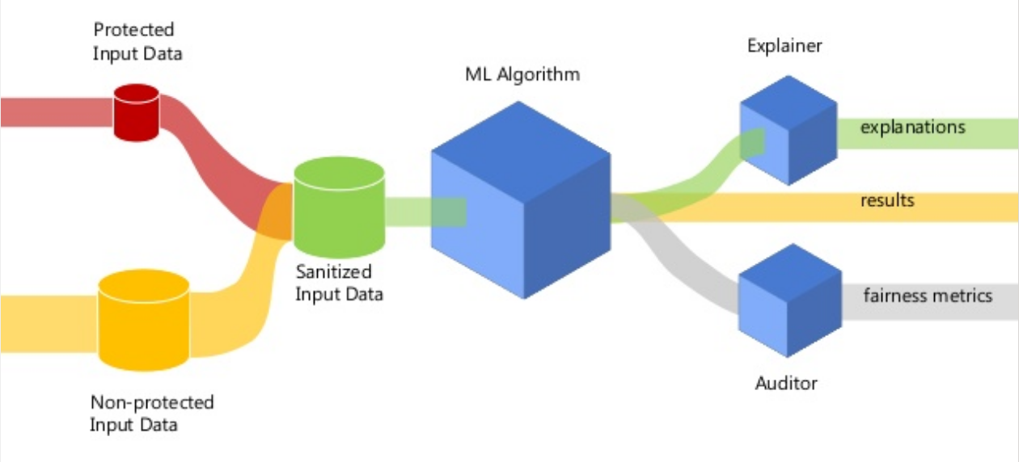
What we are seeing
Better transparency
Fairness

Slide 49
Logistics
Homework 4 released (Due Oct 23, 2020)
Midterm grade released.
One week to request any regrade request
Good video on Fairness and Transparency
https://vimeo.com/248490141

